Slide 1
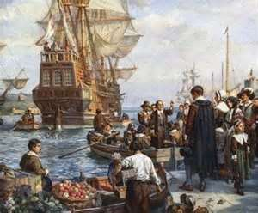
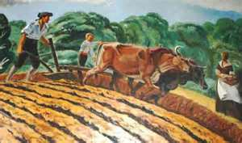
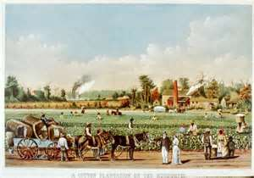
Early American Colonies
*New England, Middle & Southern Colonies
*Factors that shaped Colonial America
*Physical Features
*Economic Concepts

Slide 2
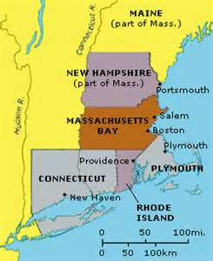
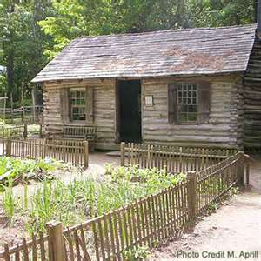
New England Colonies
Massachusetts
New Hampshire
Connecticut
Rhode Island

Slide 3
N
E
W
E
N
G
L
A
N
D
C
O
L
O
N
I
E
S
New England Colonies
Colonial Life
Came for religious freedom
Most came from England
Form of government was town hall meetings, and they used Thomas Hooker’s Fundamental Orders. They also self-governed themselves.
They had small family farms and grew wheat, corn oats, and peas.
Families were very large with an average of 8 children.
Homes were small and made of wood, and families had to sleep close to the fire because of the cold.
Reading the Bible and religion was important, but so was education. The first college was Harvard founded in 1636 in Massachusetts.
Sports were also important. They had horseracing, ice skating, bowling, and town ball.

Slide 4
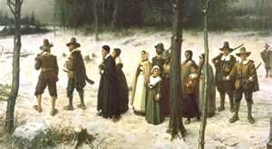
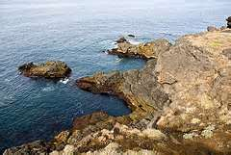
N
E
W
E
N
G
L
A
N
D
C
O
L
O
N
I
E
S
New England Colonies
Geography and Physical Features
Climate was very cold in the winter, and warm in the summer.
The Ocean was a huge part of their lives.
Physical Features included mountains, forests, and rocky coastlines.
Farming was tough because of rocky land and short growing seasons from June to September. In fact, most families could barely grow enough to feed their families.
Soil was very thin, and rocky.

Slide 5
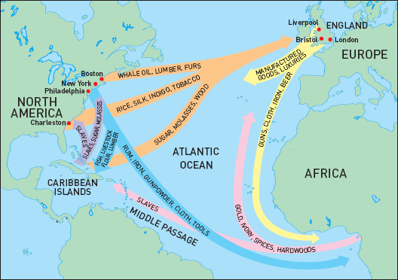
N
E
W
E
N
G
L
A
N
D
C
O
L
O
N
I
E
S
New England Colonies
Economics
Raw Materials readily available were lumber, whale products, fur, iron, cattle, corn, and fish.
Shipping Building, fur trading, and fishing were the major businesses.
Lumber and iron were a huge exports to England.
The triangular trade played a huge part in all of the colonies.

Slide 6
I
N
D
E
N
T
U
R
E
D
S
E
R
V
I
T
U
D
E
Indentured Servitude
Young men would sign contracts to be “bound” to a family for passage to the New World. These young men paid off their passage by working for the family for 5 to 7 years.
They would live with the family, and work the fields, or as house servants. Sometimes they were treated well, and other times they were treated like slaves.
Sometimes whole families would be part of the contract, and if the husband died on the ship, then the wife would have to complete the contract.
Orphans were sometimes sent, and they would be indentured until the age of 21.
At times people would flee from one owner to the next because of the way they were treated, or because they were too poor to make it on their own.

Slide 7
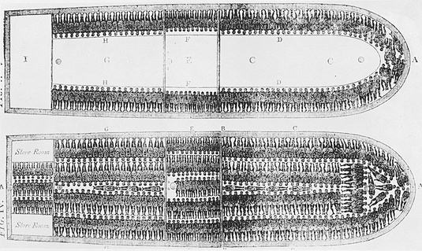
New England Colonies
Triangular Trade
T
R
I
A
N
G
U
L
A
R
T
R
A
D
E
This picture is of the slave ship Brooks retrieved from http://www.historywiz.com/africanslavery.htm

Slide 8
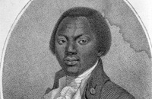
Primary Document Based Questioning
T
R
I
A
N
G
U
L
A
R
T
R
A
D
E
Middle Passage Olaudah Equiano 1756
This is an eyewitness account of Olaudah Equiano who was on the slave ship Brooks on his middle passage from Africa to the West Indies.
This picture above is from Engraving by Daniel Orme, after W. Denton, 1789. Courtesy National Portrait Gallery, Smithsonian Institution, NPG.78.82. The website is the Smithsonian National Museum of American History, and can be retrieved at http://amhistory.si.edu/onthewater/oral_histories/life_at_sea/equiano.htm

Slide 9
S
L
A
V
E
R
Y
I
N
C
O
L
O
N
I
A
L
A
M
E
R
I
C
A
Slavery in the Colonies
Upon reaching America, families were separated and people were held in slave prisons and distribution centers. Slaves were treated like cattle.
Some were sold into gang labor where they worked under an overseer that would beat or whip men if they failed to work as hard or as fast as they thought they should.
Slaves were not permitted to own property or to learn to read or write. They had no rights at all, even if their owners beat, whipped, or killed them. Children began work at 7 years old.
Sometimes slaves rebelled especially when conditions were very harsh, but rebellions were greatly feared by plantation owners and handled with brutal force.
Slaves were used all over the colonies, but the most were used in the southern colonies to plant and harvest tobacco, indigo, and rice.

Slide 10
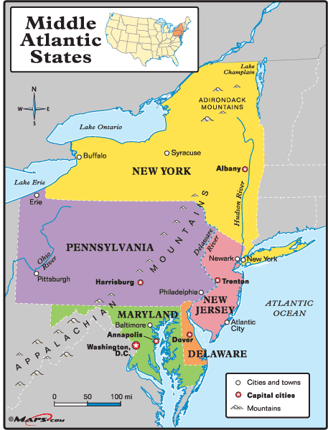
Middle Colonies
New York
New Jersey
Delaware
Pennsylvania

Slide 11
T
H
E
M
I
D
D
L
E
C
O
L
O
N
I
E
S
The Middle Colonies
Colonial Life
The settlers came from The Netherlands, Sweden, Ireland, Germany, and Scotland.
They came for religious and economic freedom. This group of settlers were very diverse in their religion like; Catholics, Jews, Lutherans, and Quakers.
Each colony had their own form of government that was connected to their religious beliefs. The colonies were headed by a Governor that was appointed by the King of England.
Most children in the middle colonies learned to read and write, but children were expected to learn a business or trade.
Homes generally had large amounts of acreage for farming, unless the family lived in the city.
Because of the diversity in culture and religion, the middle colonies were very tolerant of other.
Many indentured servants worked in the middle colonies.

Slide 12
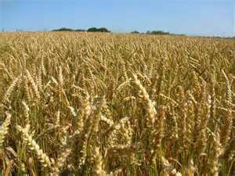
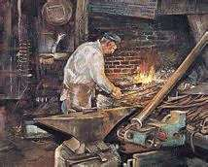
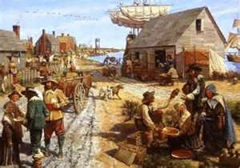
T
H
E
M
I
D
D
L
E
C
O
L
O
N
I
E
S
The Middle Colonies
Geography and Physical Features
The physical features of the middle colonies was mountains, and forests with a narrow coastal plain.
The weather in the middle colonies was very cold in the winter, and hot in the summer. They enjoyed all four seasons.
The natural resources were; lumber, cattle, iron, corn, and some furs.
The weather and fertile soil made this area excellent for farming.

Slide 13
T
H
E
M
I
D
D
L
E
C
O
L
O
N
I
E
S
The Middle Colonies
Economics
Farmers grew many different types of grain in the middle colonies, in fact, they were known as the “breadbasket” of the colonies because of it.
Farmers were able to grow more than enough to feed their families, and so they sold the surplus to make a living.
New York and Philadelphia were large cities with ports, and goods were both imported and exported. Because of the city, many shops, and artisans worked in the cities.
Because of the businesses in the city, young people could become apprentices to be trained in a skill or business. For example, Benjamin Franklin was trained as an apprentice in a printing shop.

Slide 14
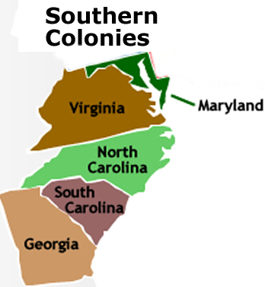
Southern Colonies
Maryland
Virginia
North Carolina
South Carolina
Georgia

Slide 15
Southern Colonies
S
O
U
T
H
E
R
N
C
O
L
O
N
I
E
S
Colonial Life
Most came from England. Some of the reasons they came were; for economic freedom, religious freedom, and others in Georgia came to escape their debts.
Religion was very important
Children mostly were taught at home by tutors or parents, and would go to college in Europe when they were in their teens.
Girls nor slaves went to school.
Most of the south was made up of large plantations with slaves or small farms.
Plantations were as large as small towns with the plantation, worker’s houses, workshops, horse stables, and fields. Plantations held a huge staff in the house and in the fields.
Backcountry farming in the south was not as profitable, and the children rarely were taught within their homes, because they lived so far away from schools. Children helped on the farm.
The King of England appointed governors, and they decided the laws.

Slide 16
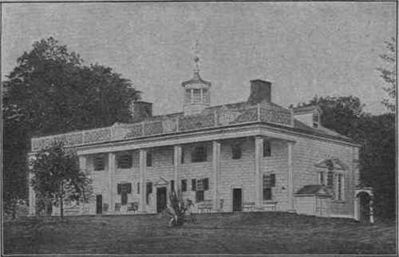
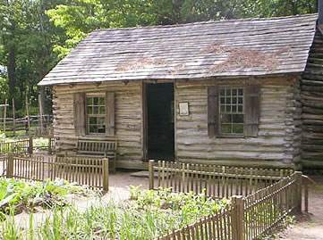
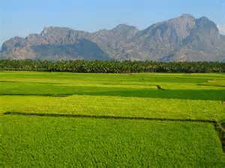
Southern Colonies
S
O
U
T
H
E
R
N
C
O
L
O
N
I
E
S
Geography and Physical Features
The physical features were a wide coastline, tidewater, mountains, and the backcountry, which included the piedmont and forests.
There were many “cash crops” where planters became rich, and the soil was very fertile.
Because of the wide coastline “cash crops,” like tobacco, indigo, and rice were easily exported.
The weather was very hot and humid summers, and very mild winters, so the growing season was long.
The natural resources were; pitch, tobacco, rice, and indigo.

Slide 17
Southern Colonies
S
O
U
T
H
E
R
N
C
O
L
O
N
I
E
S
Economics
Southern Colonies were mostly agricultural.
Plantations grew large amounts of crops in the Southern Colonies
Slaves provided most of the labor on plantations
Virginia had plantations, and grew tobacco, wheat, and corn.
South Carolina had plantations, and they grew indigo, rice, and tobacco.
North Carolina had plantation agriculture too and grew indigo, rice, and tobacco.
Maryland had mainly shipbuilding, and ironworking, but they did have some agriculture, like indigo, corn, and wheat.
Georgia grew indigo, rice, and sugar.
Most farms were small family farmers with a few servants, or slaves. The planters on plantations had lots of servants and slaves, and became very rich.
These goods from the southern colonies were exported to middle and New England colonies, as well as, other countries in the Triangular Trade.

Slide 18
References
New England Colonies- Mr. Zoller
http://www.youtube.com/watch?v=4ScZh2-QLOE
Fundamental Orders
http://www.constitution.org/bcp/fo_1639.htm
Triangular Trade
http://www.eduplace.com/kids/socsci/books/applications/imaps/maps/g5s_u3/index.html
Middle Passage – Smithsonian
http://amhistory.si.edu/onthewater/oral_histories/life_at_sea/equiano.htm
Middle Colonies – Mr. Zoller
http://www.youtube.com/watch?v=Yw9pw8rIDlU
Southern Colonies – Mr. Zoller
http://www.youtube.com/watch?v=j3KAOWye1AM

