Slide 1
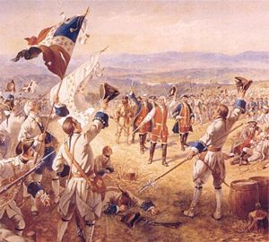
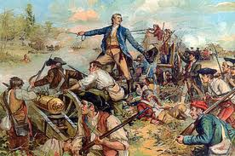
French and Indian War

Slide 2
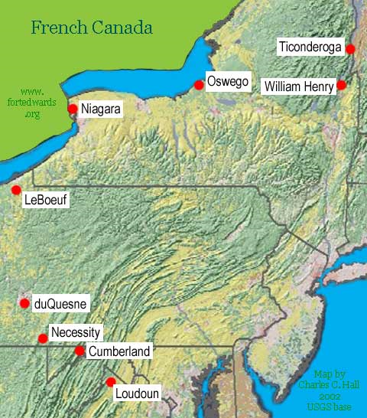
The French used the St. Lawrence River for trade, and it also provided a border between French and British land.
Washington would have his only surrender in his military career at Fort Necessity. This fort was built by Washington and his troops to protect them from French troops as they retreated from Fort Duquesne.
Fort Ticonderoga was in New Hampshire with the Green Mountain Boys and Ethan Allen.
Fort Loudon is in present day Tennessee.

Slide 4
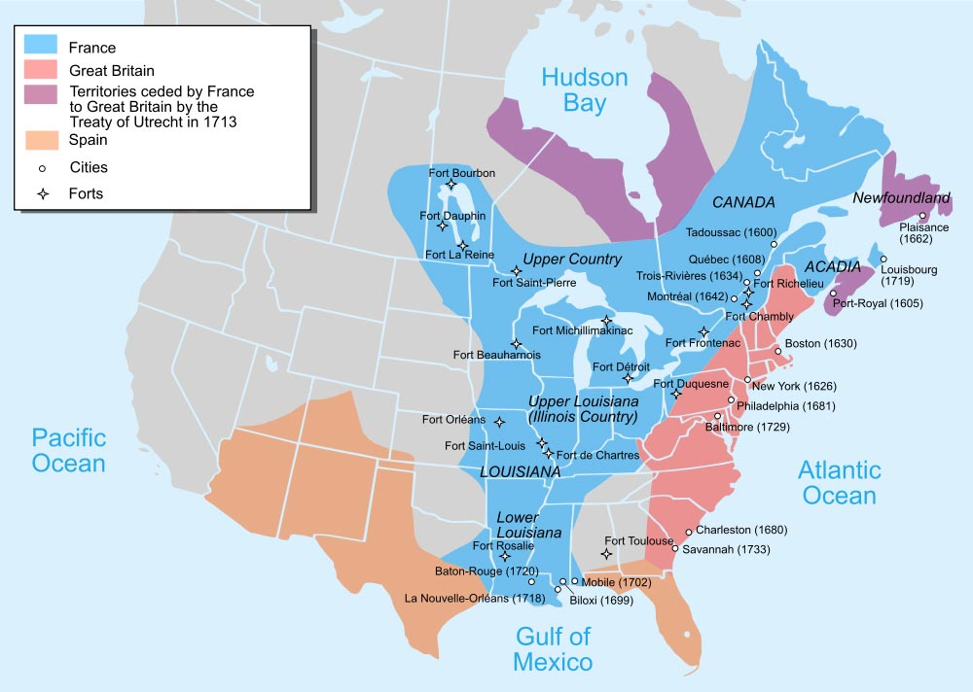
Land before the French and Indian War

Slide 5
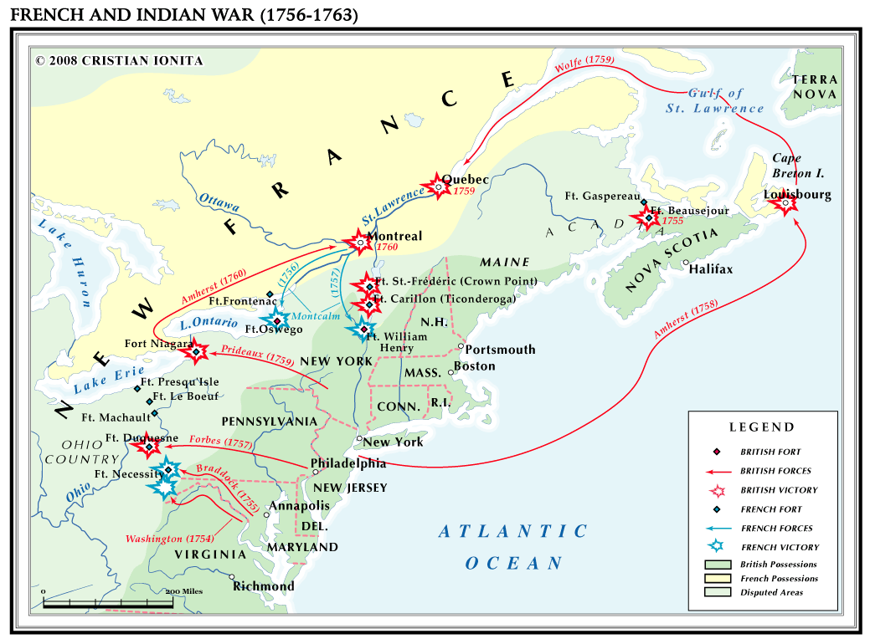

Slide 6
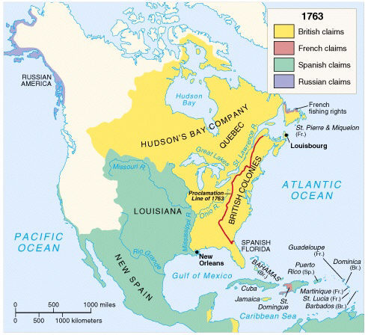
Land after the French and Indian War

Slide 7
Discussion
Compare and contrast the maps. Describe the differences and similarities.
What conclusions can you draw from these maps.
If the outcome of the war had been different, how would it have affected America?
The Road to Revolution
How does the French and Indian War affect the colonists?
What would have happened if France had won?

Slide 8
Events leading to the Revolutionary War
The French and Indian War was fought between 1754 and 1763, when the British faced a combined army of Native Americans and the French for control of the eastern portion of North America.
The battles that were fought helped shape the future of the United States, with George Washington serving as a colonel in the British army.
To finance the war, England had gone into debt. Since the war was fought mainly to protect the borders of the American colonies, the English government decided to make the Americans pay for most of that debt. This, naturally, created great unrest in America.
The French and Indian War, as Americans called it, showed the American colonists how powerful the English army and navy could be. It also showed how vulnerable these same troops could be. The Americans noticed the effectiveness of the guerrilla tactics used by the French and Native Americans. When the British tried to keep the American colonies from rebelling in 1775, the British troops faced the same kind of tactics.
Although Britain won the war, the effects led to the Declaration of independence just 13 years after the war's conclusion.

Slide 9
References
The Seven Years War retrieved at: http://www.youtube.com/watch?v=Seack6kqiGk
Map page 2 retrieved at www.fortedwards.org
Map page 4 retrieved at http://totallyhistory.com/french-and-indian-war/
Map page 5 – Ionita, C. (2008). French and Indian War (1756-1763).
http://www.shmoop.com/french-indian-war/timeline.html
http://www.timetoast.com/timelines/the-french-and-indian-war-timeline--2

