Slide 1
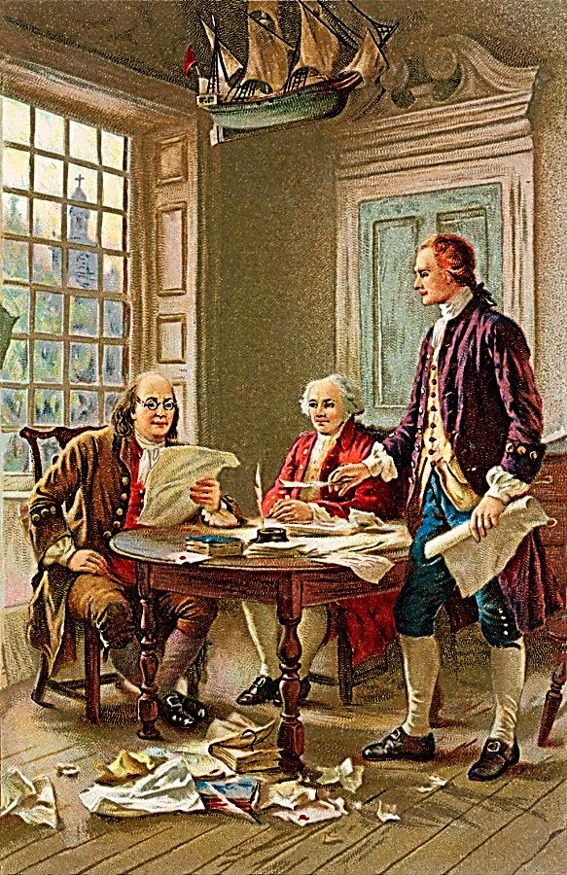
The American Revolution
The Birth of a Nation

Slide 2
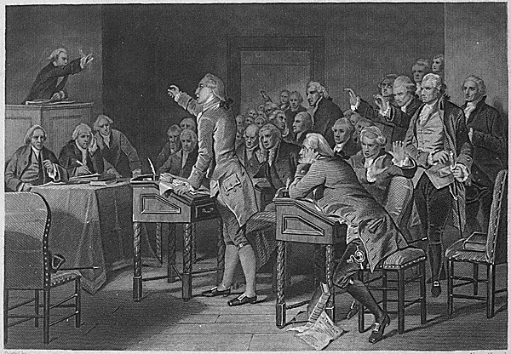
In 1763 Great Britain wins the French and Indian War.
The Proclamation of 1763 by King George III provided that all of the western territory gained from the French (the Appalachians to the Mississippi ) would be Indian territory, and the colonists would be forbidden to expand westward.
Great Britain after the war is deeply in debt, and decides to have the colonists pay for the war and continued protection by British troops.

Slide 3
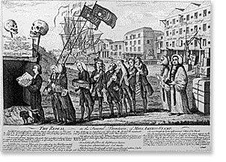
The Sugar Act of 1764
In order to pay for the French and Indian war, and the 10,000 troops England had stationed in America, England imposed the Sugar Act of 1764.
This taxed sugar, molasses, and lumber.
The effect in the colonies was outrage, because the colonies were in an economic depression and the tax limited their profits.

Slide 4
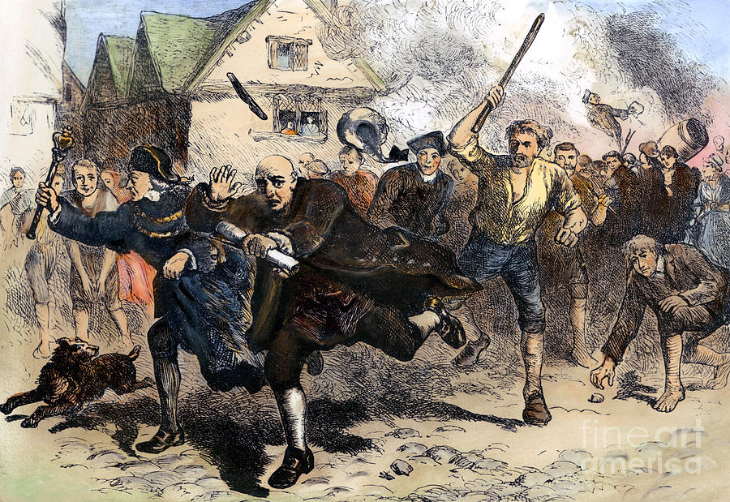
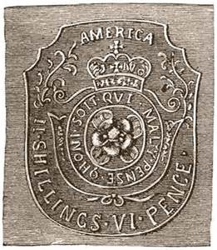
The Stamp Act of 1765
The Stamp Act of 1765 imposed a new tax on all paper items like; playing cards, documents, and newspaper.
The colonists were upset because England was raising money without the permission of the colonial legislatures. The colonists were afraid that this was just the beginning.
The colonists believed that their was nothing they could do until Patrick Henry introduced “The Stamp Act Resolves.” These stated that Americans; had the same rights as the English, should only be taxed by their representatives, and that anyone who supported the tax was an enemy of the colony.

Slide 5
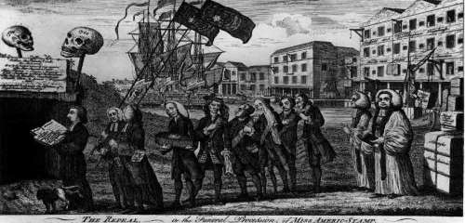

Slide 6
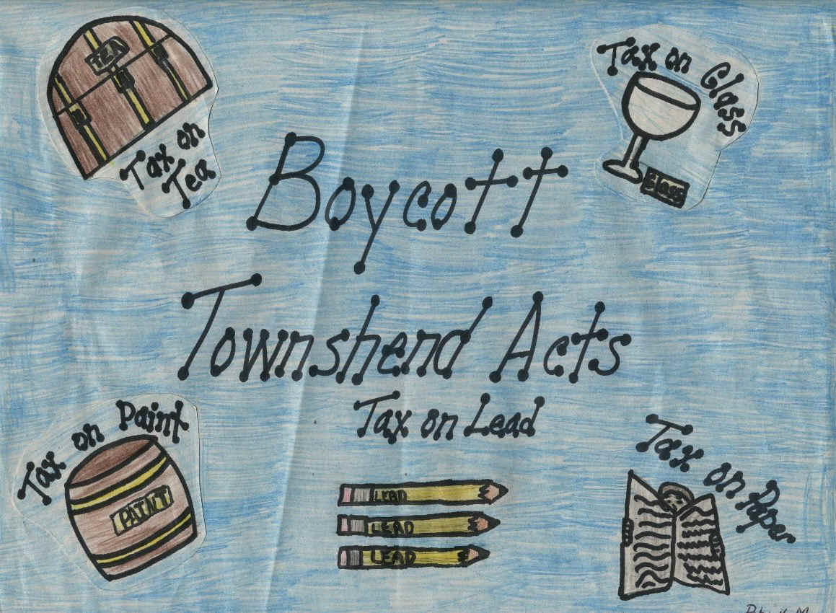
The Townshend Acts of 1767
The Townshend Acts imposed a series of taxes on all goods imported into the United States. These taxes were instituted for a couple of reasons.
First, was the ongoing need to raise revenue.
However, more important than the revenue was the desire of the parliament to show they had the right to impose the taxes.

Slide 7
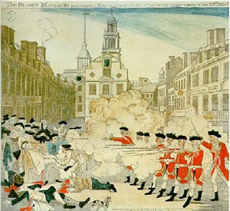
The Boston Massacre
Since 1765 the people of Boston had been heading protests against British taxation, first against the Stamp Act and then in 1767 against the Townshend Acts.
Citizens believed that Britain did not have the right to tax them because they did not elect their representatives in Parliament.
Riots and protests were common occurrences as well as attacks on tax officials.
The Boston Massacre was the killing of five colonists by British regulars on March 5, 1770.

Slide 8
Sons of Liberty – Tea Act
A boycott of British goods convinced the government that it should repeal the unpopular Townshend Duties in 1770, but insisted on retaining the tax on tea as a matter of principle.
Not surprisingly, the Americans continued to boycott tea. As a result, the East India Company had warehouses full of tea, but was teetering on the brink of bankruptcy.
The Tea Act of 1763 lowered the price on this East India tea so much that it was way below tea from other suppliers. But the American colonists saw this law as yet another means of "taxation without representation" because it meant that they couldn't buy tea from anyone else (including other colonial merchants) without spending a lot more money.
Their response was to refuse to unload the tea from the ships. This was the situation in Boston that led to the Boston Tea Party.

Slide 9
The Boston Tea pARty
The Boston Tea Party of December 16, 1773, took place when a group of Massachusetts Patriots, protesting the monopoly on American tea importation recently granted by Parliament to the East India Company, seized 342 chests of tea in a midnight raid on three tea ships and threw them into the harbor in direct response to The Tea Act of 1773.
A popular song of the day was called "Revolutionary Tea." Its first stanza was,
"There was an old lady lived over the sea, And she was an Island Queen;
Her daughter lived off in a new country, With an ocean of water between. The old lady's pockets were full of gold, But never contented was she, So she called on her daughter to pay her a tax, Of three pence a pound on her tea, Of three pence a pound on her tea."

Slide 10
The Intolerable Acts
According to the British Constitution, one cannot take away the property or taxes of a British subject without representation in the Parliament. The colonies were not represented in the Parliament, and the colonies fought against the Parliaments’ devious acts, with some even saying the Parliament has no right to take away and use the taxes. This they clearly expressed in the slogan: “No taxation without representation.”
Because of the Boston Tea Party, King George III imposed a series of acts to reign in the colonists. They were designed to punish the Americans called the Intolerable Acts.
These led to the convening of the First Continental Congress at Philadelphia on September 5. Creating the Continental Association, the congress called for a boycott of all British goods.

Slide 11
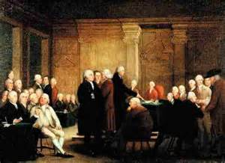
The First Continental Congress
The first Continental Congress met in Carpenter's Hall in Philadelphia, from September 5, to October 26, 1774.
It was agreeable to all that the King and Parliament must be made to understand the grievances of the colonies and that the body must do everything possible to communicate the same to the population of America, and to the rest of the world.
The congress had three objectives: to compose a statement of colonial rights, to identify British parliaments violation of those rights, and to provide a plan that would convince Britain to restore those rights.

Slide 12
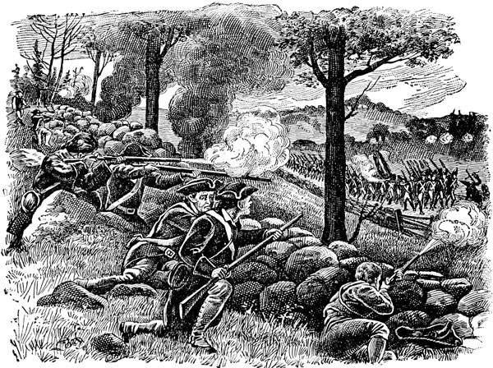
Concord and Lexington
The Colonists hid all of their weapons and gunpowder at Concord out of fear that the British would take it from them. Concord is 17 miles from Boston.
On the night of April 18, 1775, the British troops left Boston as Paul Revere, Samuel Prescott, and William Dawes warned the countryside.
In Lexington, a group of Minuteman were waiting for the redcoats. Shots rang out and 8 minutemen were killed.
When the redcoats made it to Concord, a large group of Minutemen were waiting. The British were outnumbered, and they began to retreat.
The minutemen hid behind walls, trees, and bushes to ambush the British regulars as they retreated back to Boston.
The war had begun with the first drop of British blood.

Slide 13
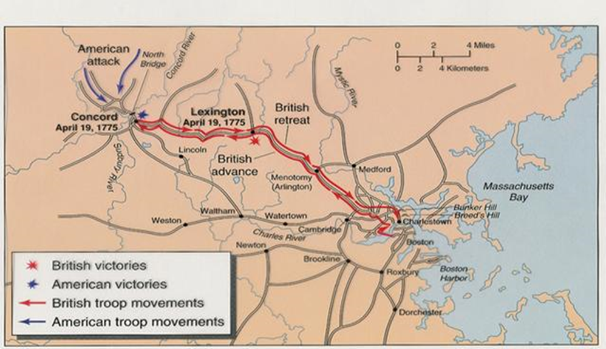
The Battles of Concord and Lexington

Slide 14
Second Continental Convention
The Second Continental Convention began meeting on May 10, 1775 in Philadelphia because of Lexington and Concord. All colonies were present except for the Georgia delegation which arrived in the fall.
John Hancock led the Congress, and George Washington was chosen as Commander-in-Chief of the military, and they also named four generals to serve under Washington.
The Congress attempted to pay for the conflict by issuing paper certificates and by borrowing from domestic and foreign sources. The effort to raise money for paying soldiers and purchasing arms and supplies remained a problem for much of the war.
The Declaration of Independence was approved on July 4, 1776, and consists of four parts; Preamble, Natural Rights, Grievances, and Independence.
The 13 colonies needed a constitution to unify and govern, so the congress voted to have a committee of 13 prepare a draft. This is the Articles of Confederation, which was not ratified until March 1, 1781.

Slide 15
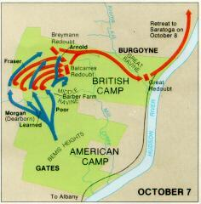
Battle of Saratoga
As 1776 ended, the cause for American Independence seemed all but lost. It was true that Washington’s successful gamble at the battles of Trenton and Princeton kept hopes alive, but the British were still holding the upper hand.
In Saratoga, New York, Generals Horatio Gates and Benedict Arnold led the Patriots, and the General Burgoyne and his British troops retreated.
This was the turning point of the war, because it was then that the colonists finally looked like they had a chance to win. With this victory, the French sent ships and soldiers.

Slide 16
Battle of Yorktown
In August 1781, the Patriot’s led by George Washington marched to Yorktown, and were joined by French soldiers. Together they out numbered the British.
General Cornwallis, a British General, believed that British ships would arrive to bring more troops, but they never did.
As the fighting raged, more French ships arrived cutting off the British, and forcing them to surrender.
On October 17, 1781, the British officially surrendered and America had won the war!
Peace talks began in Paris, and in September 1783, the Treaty of Paris was signed and the war was finally over!

Slide 17
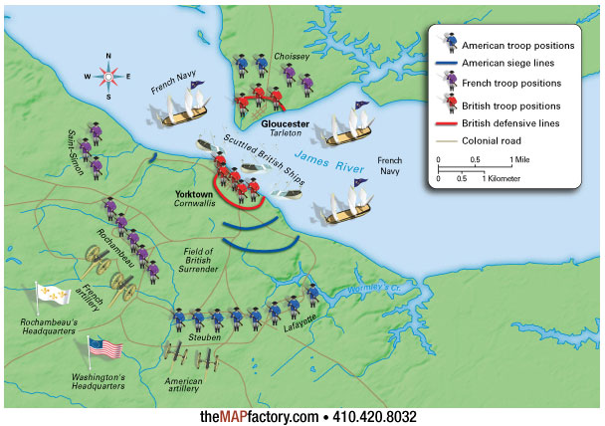

Slide 18
1st Constitution
Articles of Confederation 1777
John Dickinson wrote the Articles of Confederation during the Revolutionary War. The articles were written to give the colonies some sense of a unified government. Once the thirteen colonies became the thirteen states, however, each one began to act alone in its own best interest. A new governing document was needed in order for these new states to act together, to become a nation.
The Articles of Confederation became effective on March 1, 1781, after all thirteen states had ratified them. The Articles made the states and legislature supreme. There was no executive branch. Judicial functions were very limited.
The resulting government was weak. Efforts to make it stronger failed. A convention called in May 1787 to re-write the Articles decided to draft an entirely new Constitution.
The Articles of Confederation were used from 1781-1789.

Slide 19
How were the Articles of Confederation weak?
Each state had their own currency
No executive Branch (President)
No regulation of interstate commerce (for trade)
No national court system (Judicial Branch-Supreme Court)
9 out of 13 states had to agree to pass a law
13 out of 13 states had to agree for an amendment
No national army
Congress had no power to tax, and as a result was not paying the debts left over from the Revolution.
Constitutional Convention 1787
55 Delegates attended in secret
Met to amend the Articles of Confederation, but they decided to write a new constitution.

Slide 20
United States Constitution
The Compromises
The Great Compromise
a. Virginia Plan from James Madison – the greater the population of a
state, the greater the representation.
b. The New Jersey Plan – All states should have equal representation
so that small states will have a say too.
It was decided that the legislative (law-making) body would be bicameral.
bi = two, and cameral = chamber or house
So we have two chambers that make laws, one is based on population
(House), and one has equal representation from every state (Senate),
and that number is 2.

Slide 21
United States Constitution
Three-fifths Compromise – Do slaves count as population?
a. South wanted slaves to count for population for representatives, but
not for taxes.
b. North wanted slaves to count towards taxes, but not representation.
A compromise of 3/5 was reached. Each slave would count as 3/5 of a person for both taxes and representation.
3. Commercial Compromise – Tax imports and not exports – Called a tariff
Document
DBQ’S

Slide 22
Anti-Federalists vs Federalists
Anti-Federalists (strong state) Federalists (strong national)
George Mason George Washington
Richard Henry Lee Alexander Hamilton
Patrick Henry James Madison
Thomas Jefferson John Adams
James Madison - Father of the Constitution
After living under the tyranny of a King, Madison believed that a strong central government was necessary to protect the people.
He also believed that a republic was the only way to keep order and protect people.
A republic is where the people elect leaders to represent them. The power comes from the people.

Slide 23
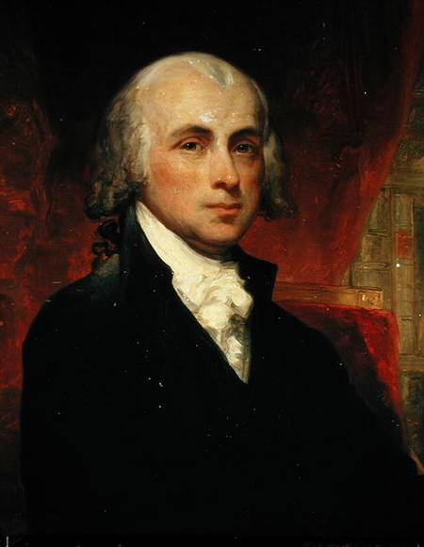
Constitution
At the Philadelphia Convention in 1787, James Madison proposed the Virginia Plan, which in essence was the establishment of the modern three-branch Federal system.
Some of the other delegates, anti-federalists, argued for individual rights, so that the freedom and rights of people would be protected from a government. Madison later acknowledged their concerns by writing the Bill of Rights, which are the first 10 amendments to the constitution in 1791.
James Madison was a prime author of what became known as The Federalist—a reprinted series of newspaper and then pamphlet articles written to convince people to support the Constitution.
Madison took notes through the debates, and it is through these notes that we know much of what happened in creating our Constitution.

Slide 24
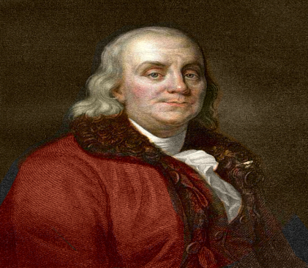
Benjamin Franklin
Although Franklin was eighty-one years old and in generally poor health, he participated as a delegate to the Constitutional Convention in Philadelphia with George Washington presiding. Many of the delegates had widely different ideas about how the country should be organized and run, including Franklin.
The convention deliberated over a way to provide equal representation for both small and large states. Franklin helped break the deadlock and pave the way for what became known as the "great compromise.“
In September 1787, the Constitution was completed, but many delegates were disgruntled. Franklin wrote an impassioned speech, in which he used his persuasive powers to urge all delegates to sign the Constitution. Franklin admitted that it was an imperfect document but probably the best they could expect. Since he was too weak from illness to give the speech himself, he had fellow Pennsylvanian James Wilson deliver the speech. Many believed this speech is what helped the Constitution get ratified.

Slide 25
Document Based Questioning
United States Constitution
Benjamin Franklin’s Speech
Why is Benjamin Franklin’s Speech important to the adopting of the Constitution?
Does Benjamin Franklin support the Constitution?
Provide evidence from the speech that proves your stance.

Slide 26
Bill of Rights 1791
Document
After the leaders of the new United States wrote the Constitution, they had to get the thirteen states to agree to it.
Some of the states didn't want to agree unless they could add some specific rights for individual people. So in 1791 the United States added ten new rights to the Constitution. These are called the Bill of Rights.
They were created to limit the power of the government by addressing the job of each branch, as well as, the limitation of their power by using “checks and balances.”
After the tyranny of King George III, many wanted to ensure our “natural rights” including our right to property.

Slide 27
References
The Boston Massacre
http://www.youtube.com/watch?v=iloGkp5f_Hk&list=PL0FA70DDD0BE43E6E
The Boston Tea Party
http://www.youtube.com/watch?v=CwEX_YVyAS4&list=PL0FA70DDD0BE43E6E
The First Continental Congress
http://www.youtube.com/watch?v=f6iITHT8LJE&list=PL0FA70DDD0BE43E6E
Concord and Lexington
http://www.youtube.com/watch?v=hiIFRCk1hxY&list=PL0FA70DDD0BE43E6E
Saratoga
http://www.youtube.com/watch?v=txeNC-zG34w
Yorktown
http://www.youtube.com/watch?v=42ttoxU_qxI
Articles of Confederation
http://www.youtube.com/watch?v=h10eSXRFsTM

Slide 28
References
Weakness of The Articles of Confederation
http://www.youtube.com/watch?v=vlpIbuAUfqQ
United States Constitution Video
http://www.youtube.com/watch?v=GXJ-q9Z_n-E
United States Constitution Document Based Questioning
http://www.mybookezzz.com/ebook.php?u=aHR0cDovL3d3dy5yb2FkbWFwdG9sYXN0YmVzdGhvcGUuY29tL3NpdGVzL2RlZmF1bHQvZmlsZXMvNS0xNi0xMFZJREJRTGF1cmFITUgucGRmClNhbXBsZSBEb2N1bWVudCBCYXNlZCBRdWVzdGlvbiBFc3NheSBWb2x1bWUgSSAtIExhc3QgQmVzdCBIb3Bl
United States Constitution Document
http://www.youtube.com/watch?v=0NVVjIriFeE
James Madison
http://www.youtube.com/watch?v=d4W4YgRBQbs
Benjamin Franklin Speech
http://www.americanrhetoric.com/speeches/benfranklin1787.htm
Bill of Rights Document
http://www.archives.gov/exhibits/charters/bill_of_rights.html

